Slide 1




BUILDING A CALCULATOR

Slide 2






2
IN THIS PPT
1.About the project
2.the calculator
3.It’s Uniqueness
4.Libraries Used
5.Challenges
6.References

Slide 3





ABOUT THE PROJECT
The calculator project helped in
understanding how graphical user
interfaces (GUI) are developed using
Python programming. This project was
designed as a scientific calculator
with advanced mathematical
operations. It enhanced my knowledge
about Python libraries and how real-
world applications like calculators are
created using programming logic and
GUI components

Slide 4


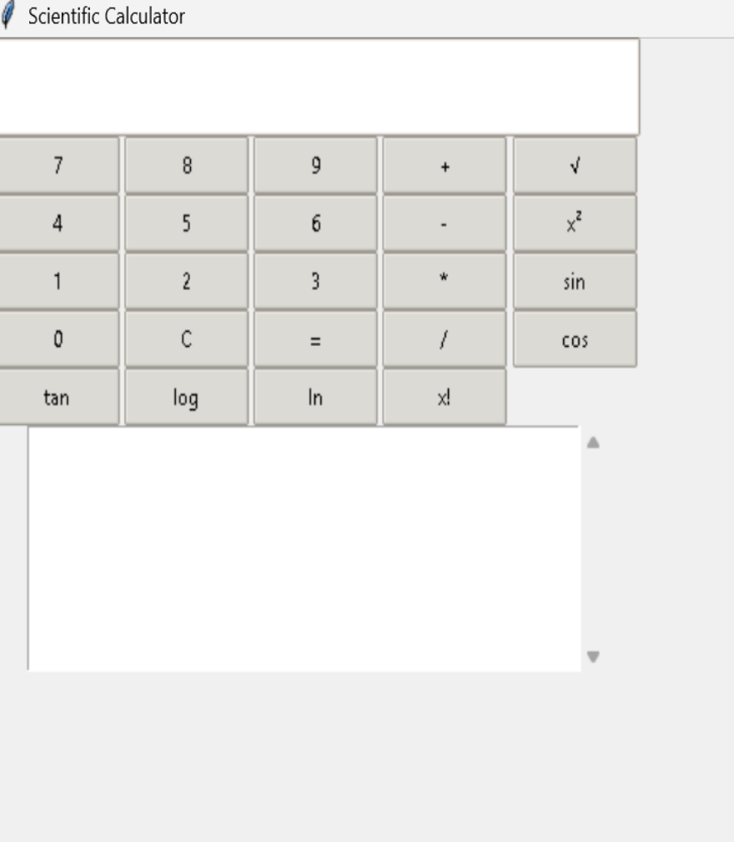


THE CALCULATOR
This calculator is developed
using Tkinter library of Python
which helps in creating
graphical user interface.
It can perform arithmetic
operations like addition,
subtraction, multiplication and
●Second level
Along with that, it also supports
scientific operations like sine,
cosine, tangent, logarithm and
square functions.

Slide 5






5
UNIQUE FEATURES
●This calculator is unique because it is not just a simple
calculator but also works as a scientific calculator.
●It provides real time calculation with interactive button
layout.
●It includes trigonometric functions, logarithmic
calculations and power functions.
●The graphical user interface makes it easy to use

Slide 6



LIBRARIES USED
6
LIBRARY | USED FOR | EXAMPLE
Tkinter | to create the graphical user interface | ●Buttons ●Display screen Layout management
Math Library | to perform scientific and mathematical calculations | ●Square root ●Trigonometric functions (sin, cos, tan)●Logarithmic functions ●Factorial operations
ttk Library | to improve the appearance of the calculator | ●Creating modern styled buttons ●Providing a better graphical theme
Scrolled Text | to create a history section which | ●Displays previously calculated values ●Improves usability of the calculator

Slide 7




‹#›
CHALLENGES FACED
●Difficulty in implementing scientific functions like
●Second level
●Second level
●Managing the display of values dynamically on screen
●Handling errors during calculation like invalid inputs
●Creating a proper layout for all buttons within limited
window size
●Integrating history feature with calculation output

Slide 8

8
OVERCOMING CHALLENGES
●Used Python's math library to perform complex scientific operations
●Implemented String Var() to dynamically update display values
●Used try-except block to handle errors effectively
Fourth level
●Applied grid layout method for proper button arrangement
●Fifth level
●Used Scrolled Text widget to maintain calculation history

Slide 9
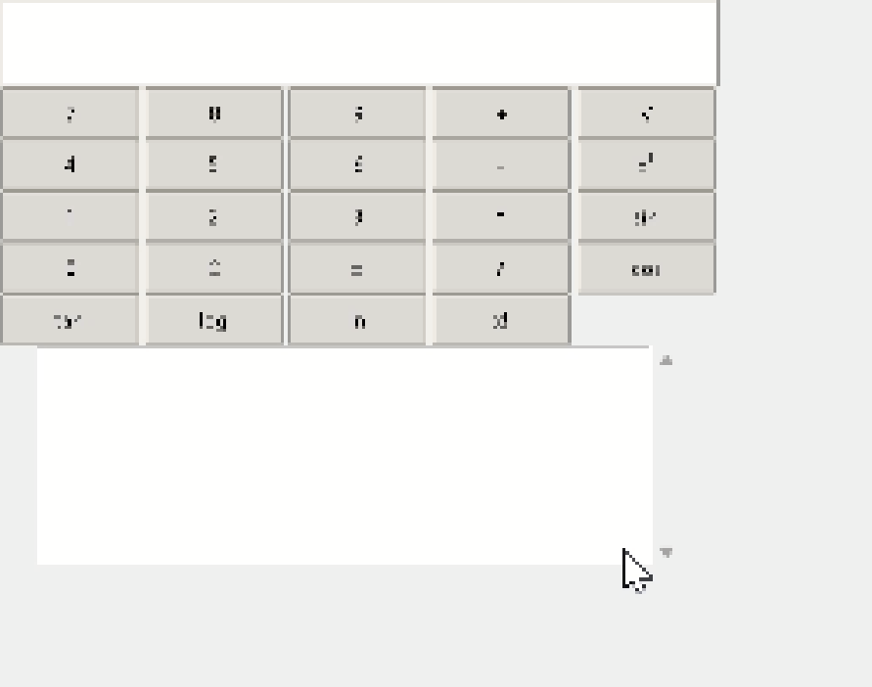




9
WORKING DEMONSTRATION

Slide 10





10
REFERENCES
●Python Official Documentation
●Tkinter GUI Documentation
●Online programming tutorials and learning
resources
●YouTube tutorials for GUI -based calculator
implementation

Slide 11




Thank
you
BY: MILLEE CHAUDHARY
TO: NEXTHIKES IT SOLUTIONS
millee857@gmail.com
milich1904@gmail.com

